Slide 1

Fair digital framework fair digital object + ldp
Luiz Bonino
luiz.bonino@go-fair.org

Slide 2
Automated client exploration
The FAIR principles focus on machine actionability —> “The Machine knows what I mean”;
“This necessitates machines to be capable of autonomously and appropriately acting when faced with the wide range of types, formats, and access-mechanisms/protocols that will be encountered during their self-guided exploration of the global data ecosystem.”
Wilkinson, M. D. et al. The FAIR Guiding Principles for scientific data management and stewardship. Sci. Data 3:160018 doi: 10.1038/sdata.2016.18 (2016).
This expects that artificial agents are able to explore the environment to get the elements they need to operate.
In summary, it is expected that the agent finds a resource, retrieves it, interprets its content and decides where to go from there. This behaviour can be summarised as:
get information → interpret → decide → get information → interpret → decide…

Slide 3



Automated client exploration
1 - resolve resource identifier
Identifier
Client

Slide 4

Automated client exploration
1 - resolve resource identifier
Identifier
Client
2 - return (information about) the resource

Slide 5
Automated client exploration
Client
interpret the (information about the) resource

Slide 6
Automated client exploration
Where should I go from here, operate on the resource or know more about it?
Client
interpret the (information about the) resource and decide what to do
Notes:
And then start the process again with the newly acquired information

Slide 7
Fair principles
Findable
F1. (meta)data are assigned a globally unique and persistent identifier;
F2. data are described with rich metadata
F3. metadata clearly and explicitly include the identifier of the data it describes;
F4. (meta)data are registered or indexed in a searchable resource;
Accessible
A1. (meta)data are retrievable by their identifier using a standardised communications protocol;
A1.1. the protocol is open, free and universally implementable;
A1.2. the protocol allows for an authentication and authorisation procedure, where necessary;
A2. Metadata are accessible, even when the data are no longer available;
Interoperable
I1. (meta)data use a formal, accessible, shared and broadly applicable language for knowledge representation;
I2. (meta)data use vocabularies that follow FAIR principles;
I3. (meta)data include qualified references to other (meta)data;
Reusable
R1. (meta)data are richly described with a plurality of accurate and relevant attributes;
R1.1. (meta)data are released with a clear and accessible data usage license;
R1.2. (meta)data are associated with detailed provenance;
R1.3. (meta)data meet domain-relevant community standards;
DOI: 10.1038/sdata.2016.18
Notes:
In the FAIR principles we can distinguish between parts that can be fulfilled by technical infrastructure and parts that are fulfilled through social agreements/contracts. In green we see that parts that can be covered by technical infrastructure.

Slide 8
FAIR Digital Framework
Framework that adopts the FAIR Digital Object (FDO) model applying Linked Data Platform (LDP) technology when applicable and adequate

Slide 9
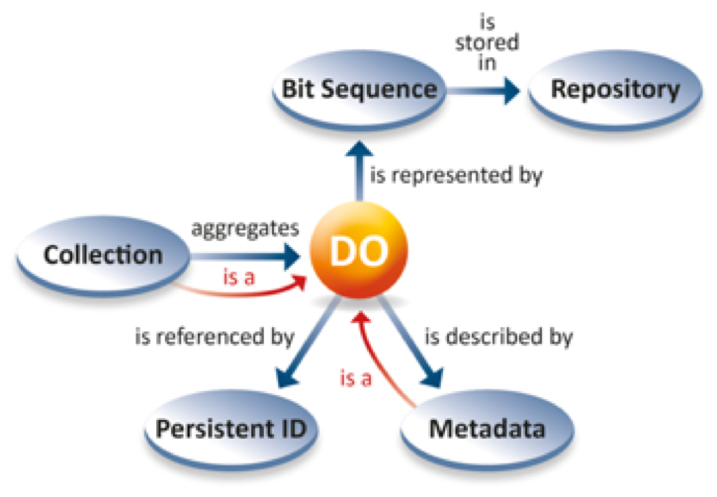
Fair digital Framework - conceptual framework
Architectural layer

Slide 10
Fair digital Framework - conceptual framework
Architectural layer
Linked Data Platform
Implementation layer

Slide 11
Fair digital Framework - conceptual framework
<<FDF Object>>
Metadata
hasMetadata
1..*
Resource
1
isMetadataOf
FAIR Digital Object
0..*
<<FDFType>>
represents
<<FDF Object>>
Globally Unique, Persistent and Resolvable Identifier
identifies
1
0..*
contains/collections

Slide 12
Fair digital Framework - conceptual framework
semantic representation
<<FDF Object>>
Metadata
semantic type
hasMetadata
1..*
Resource
1
isMetadataOf
FAIR Digital Object
0..*
<<FDF Type>>
represents
<<FDF Object>>
Globally Unique, Persistent and Resolvable Identifier
identifies
1
0..*
Semantic
representation
contains/ collections

Slide 13
Fair digital Framework vs fair digital object
Resource
represents
FAIR Digital Object
<<FDFType>>
contains/
collections
0..*
isMetadataOf
identifies
hasMetadata
<<FDF Object Identifier>>
GUPRI
<<FDF Object Metadata>>
Metadata
Notes:
Very similar

Slide 14
Fair digital framework - minimal implementation
GUPRI

Slide 15
Fair digital framework - minimal implementation
FAIR Digital Identifier Record
GUPRI
resolvesTo

Slide 16
Fair digital framework - minimal implementation
<<LDP RDF Source>>
Metadata
fdf:hasMetadata
1..*
1
fdfIsMetadataOf
FAIR Digital Record
<<LDP RDF Source>>
GUPRI
resolvesTo
fdf:represents
0..*
Resource
ldp:isMemberOf
0..*
ldp:contains
0..*

Slide 17
Fair digital framework - minimal implementation
<<LDP RDF Source>>
Metadata
fdf:hasMetadata
1..*
1
fdfIsMetadataOf
FAIR Digital Record
<<LDP RDF Source>>
<<FD Object>>
GUPRI
resolvesTo
fdf:represents
0..*
Resource
ldp:isMemberOf
0..*
ldp:contains
0..*

Slide 18
Fair digital framework - minimal implementation
<<LDP RDF Source>>
Metadata
has type fdf:Metadata
Semantic Representation
fdf:hasMetadata
1..*
has type fdf:Record
1
fdfIsMetadataOf
FAIR Digital Record
<<LDP RDF Source>>
has type fdf:GUPRI
fdf:identifies
1
fdf:represents
0..*
<<FDF Object>>
Globally Unique, Persistent and Resolvable Identifier
Resource
ldp:isMemberOf
0..*
ldp:contains
0..*

Slide 19
How does it work from a client perspective (get information —> interpret —> decide)?

Slide 20
Fair digital framework - concrete schema
<<FDFType:FDFRecord>>
hasIdentifier: identifier
hasMetadata: {metadataIdentifier}
hasType: <<FDFOntologyType>>
hasResource: {resourceLocator}
…
<<FDFType:Identifier>>
GUPRI
resolvesTo
1

Slide 21
Fair digital framework - identifier resolution
1 - resolve FDF identifier
GET(identifierURL)
Identifier
Client
Notes:
Using the current internet/web infrastructure

Slide 22

Fair digital framework - identifier resolution
1 - resolve FDF identifier
GET(identifierURL)
Identifier
Client
2 - return FDF record
FDF Server
FDF
hasIdentifier: fdfIdentifier
hasMetadata*: {metadataIdentifier}
hasType: FDFType
hasResourceLocation*: {FDFLocation} .

Slide 23
Fair digital framework - client interpretation/decision
Do I want the actual resource or know more about it (metadata)?
FDF
hasIdentifier: fdfIdentifier
hasMetadata*: {metadataIdentifier}
hasType: FDFType
hasResourceLocation*: {FDFLocation} .
Client

Slide 24
Fair digital framework - client interpretation/decision
I want to know more about it.
FDF
hasIdentifier: fdfIdentifier
hasMetadata*: {metadataIdentifier}
hasType: FDFType
hasResourceLocation*: {FDFLocation} .
Client

Slide 25
Fair digital framework - client interpretation/decision
FDF
hasIdentifier: fdfIdentifier
hasMetadata*: {metadataIdentifier}
hasType: FDFType
hasResourceLocation*: {FDFLocation} .
Client

Slide 26
Fair digital framework - identifier resolution
1 - resolve metadata identifier
GET(metadataIdentifierURL)
Identifier
Client

Slide 27
Fair digital framework - identifier resolution
1 - resolve metadata identifier
GET(metadataIdentifierURL)
Identifier
Client
2 - return metadata record
FDFMetadata
hasIdentifier: fdfMetadataIdentifier
hasType: <<FDFMetadata>>
isMetadataOf: fdfIdentifier
provenance
license
Intrinsic properties
semantic model
…
FDF Server

Slide 28
Fair digital framework - client interpretation/decision
Now that I know more about it, I want the object.
FDFMetadata
hasIdentifier: fdfMetadataIdentifier
hasType: <<FDFMetadata>>
isMetadataOf: fdfIdentifier
provenance
license
Intrinsic properties
semantic model
…
Client
FDF
hasIdentifier: fdfIdentifier
hasMetadata*: {metadataIdentifier}
hasType: FDFType
hasResourceLocation*: {FDFLocation} .

Slide 29
Fair digital framework - client interpretation/decision
Now that I know more about it, I want to operate on the object.
FDFMetadata
hasIdentifier: fdfMetadataIdentifier
hasType: <<FDFMetadata>>
isMetadataOf: fdfIdentifier
provenance
license
Intrinsic properties
semantic model
…
Client
FDF
hasIdentifier: fdfIdentifier
hasMetadata*: {metadataIdentifier}
hasType: FDFType
hasResourceLocation*: {FDFLocation} .

Slide 30
Fair digital framework - identifier resolution
1 - resolve FDF location
GET(fdfLocation)
or any CRUD/extended operation
Identifier
Client

Slide 31
Fair digital framework - identifier resolution
1 - resolve FDF location
GET(FDFLocation)
Identifier
Client
2 - return resource
Server

Slide 32


